Slide 1
Proximity-Based
IOT Enabled
Contactless Payment System

Slide 2
Overview of the Solution
Problem:
Traditional payment methods are slow, inconvenient, and prone to security risks.
The need for a faster, safer, and more hygienic payment solution.
Solution:
Our app leverages the power of IoT devices and cutting-edge technology to provide a seamless contactless payment experience.

Slide 3
App Features
Core Features:
NFC-enabled payments
PIN authentication
Real-time transaction history
Push notifications
User-friendly interface

Slide 4
Development Process
Frontend:
React Native: A powerful framework for building cross-platform mobile apps, ensuring a consistent user experience across different devices.
Backend:
Node.js: A versatile and efficient JavaScript runtime environment for building scalable backend services.

Slide 5
User Interface and User Experience
Minimalistic Design: A clean and intuitive interface designed for small screens.
Easy Navigation: Simple gestures and clear visual cues for effortless user interaction.
Secure Authentication: PIN authentication for enhanced security.
Real-time Notifications: Push notifications for transaction confirmations and alerts.

Slide 6
Challenges and learnings
Challenges:
Security: Ensuring robust security measures to protect user data.
Solutions:
Optimized code and efficient use of resources.
Strong encryption and secure communication protocols.

Slide 7
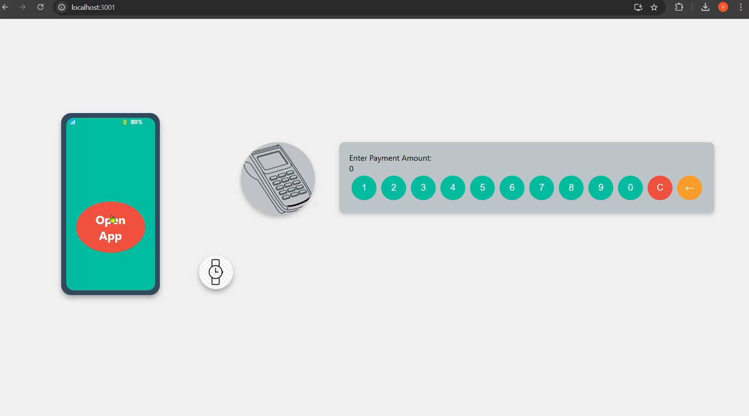

Slide 8
Future Scope
Additional Features:
Peer-to-peer payments
Loyalty programs and rewards
Integration with other IoT devices
Scalability:
Cloud-based infrastructure for scalability and reliability.
Load balancing and caching techniques to handle increased traffic.
Continuous monitoring and performance optimization.

